Slide 1
Nifty Node Network
Rushad Antia

Slide 2
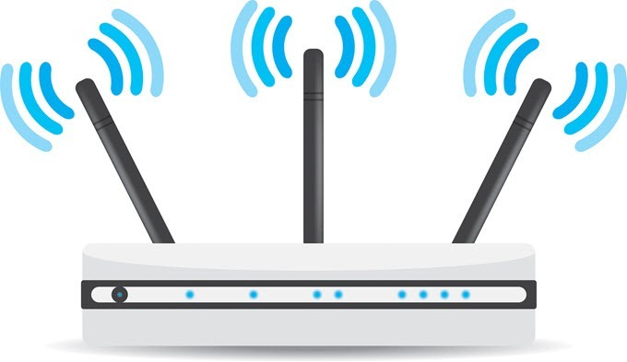
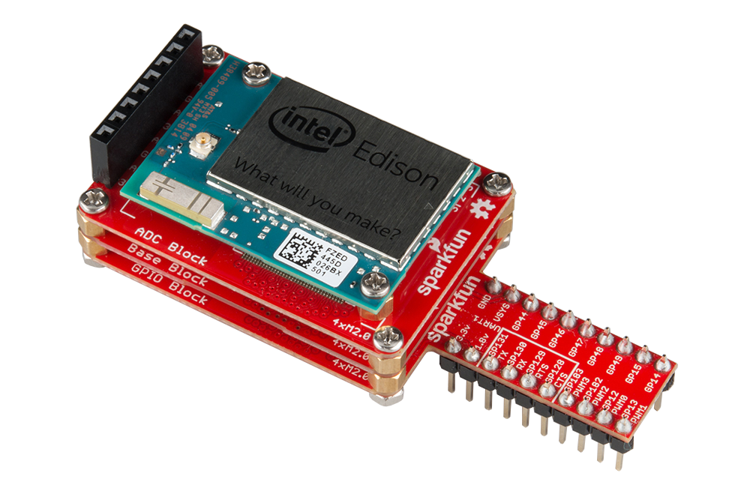

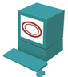
“Master Node”
Used for discovery of nodes on the network
Runs server at static ip
Nodes connect and exchange information (hostname, ip, sensors, want)
Holds table of connected devices
Ability to reboot, reset, and upload code to nodes
Node requests information about the network
MN responds by sending a list of connected devices to that node
edison01
10.20.0.10
[H] temp
[W] light
RJ-45
edison02
10.20.0.11
[H] humid
[W] button
Node Table:
edison01:10.20.0.10:temp:light
edison02:10.20.0.11:humid:button
edison03:10.20.0.12:light:temp
edison03
10.20.0.12
[H] light
[W] temp

Slide 3
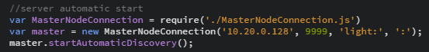
Slave Node (Provisioning)
Creates object to connect to the Master Node
User inputs list of sensors that the node has
User starts the master node connection

Slide 4

Slave Node (joining) old
Give me connected node info!!
Here you go
Connects to master node
Requests other connected nodes information
Sees which nodes has what it wants
Makes connections to the nodes that have what it wants
Cons:
Not scalable to bigger network
Nodes don’t care about things they don’t need
Hmm…who has a light sensor?
I do!!!
Me too!!!
Lets get to know each other

Slide 5
Slave Node (joining) new
Edison02
Has: Light
Wants: Button
Based on ROS pub/sub system (thanks Tim!)
Node connects to master node
Master node sees what the new node has/wants
Sends info of new devices to other devices based on what the new one has
Pros:
Makes the master node do all the work
Nodes only get info about things they care about
Scalable
Here are devices you should connect to
Before
Edison05
Has:
Wants: Button, Light
Edison01
Has:
Wants: Button, Light
Edison03
Has: Button
Wants: Light
Edison04
Has:
Wants: Button, Light
Edison06
Has:
Wants: Button, Light

Slide 6
After Edison02 Joins
Edison03
Has: Button
Wants: Light
Edison02
Has: Light
Wants: Button
Edison01
Has:
Wants: Button, Light
Edison05
Has:
Wants: Button, Light
Edison06
Has:
Wants: Button, Light
Edison04
Has:
Wants: Button, Light

Slide 7
For the future
Make a website where you can monitor the nodes
Mobile code for custom actuation
Some way to auto reconnect
Some way to announce a disconnect from the network

Slide 8
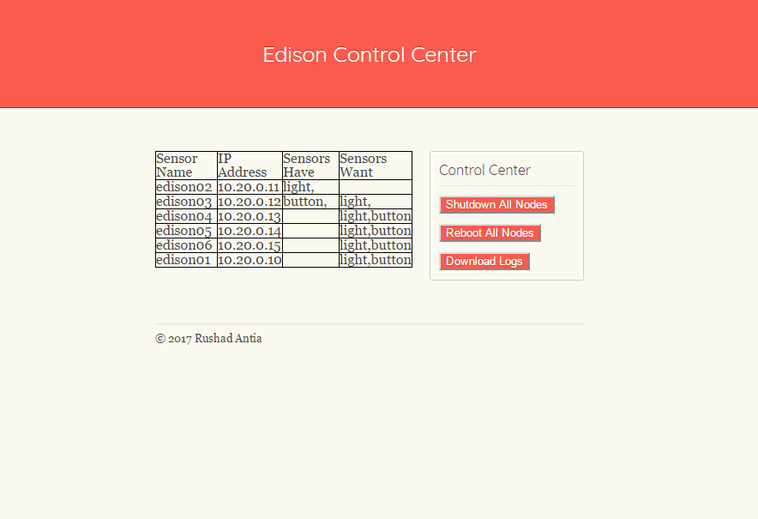
Edison Control Center

Slide 9
Demo

Slide 10
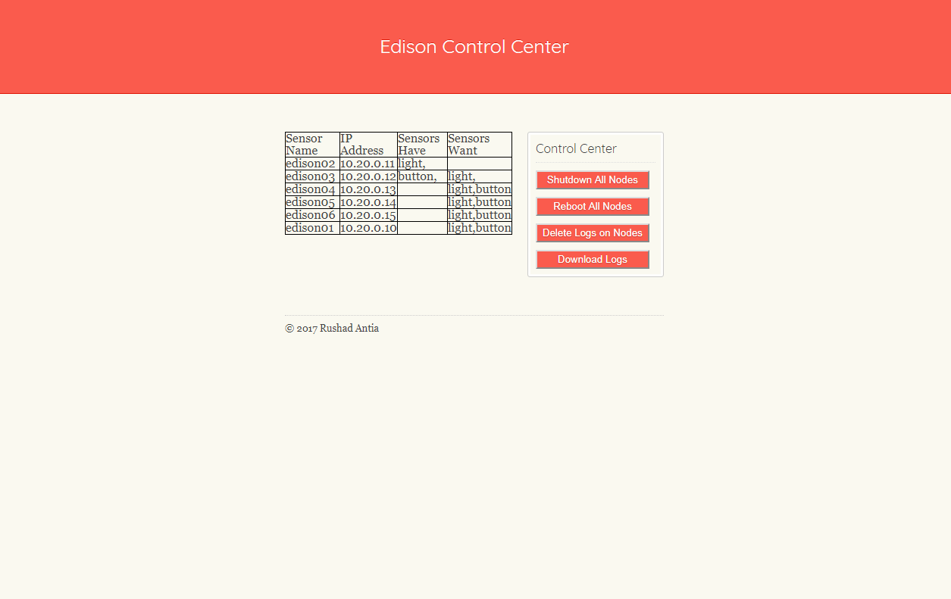
Logs
Fetches all the logs from devices through scp
Zips all the logs and lets the user download them

Slide 11
Logs Demo

